Slide 1


Stock Performance Analysis with Regression Based Machine Learning
Adam Henze

Slide 2
Problem Definition
Gather data from financial markets
Develop stock performance criteria
Develop stock indicating attributes
Correlate between performance metrics and attributes
Train machine model to perform accurate predictions with data

Slide 3
Motivation for the problem
Initiate interest in financial systems
Develop understanding of using data science with real data
Investigate further applications for growth in potential fields

Slide 4
Data Description
Data gathered from financial markets
Independent Indicators developed on stock performance and company attributes
book value to price ratio: B/P
sales to price ratio: S/P
return on equity: ROE
return rate in the last quarter
market capitalization
systematic risk

Slide 5
Data Description Cont.
Total attributes of the company are weighted to a total value of 1
Several dependent variables to search for correlations towards
Data normalized across all members

Slide 6
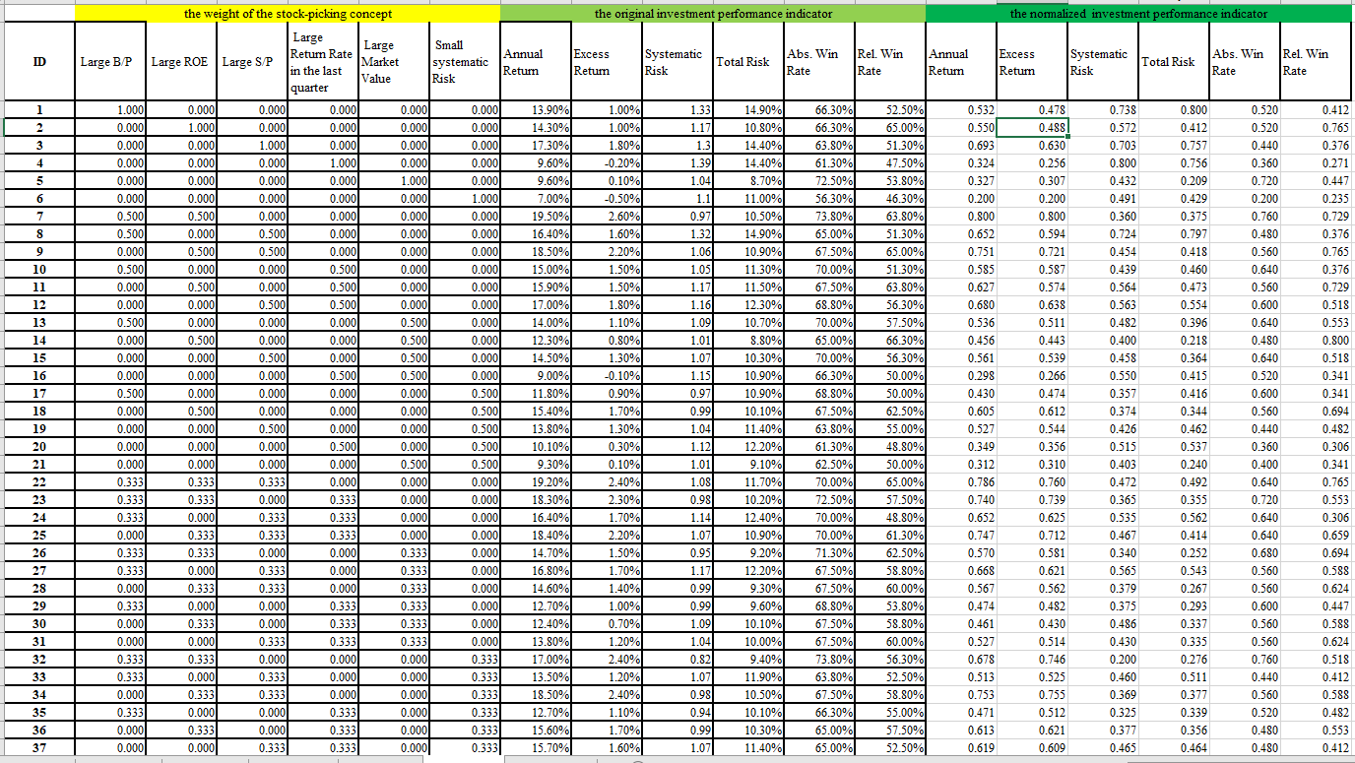

Slide 7
Data Description Cont.
Dependent Variables from stock performance records
Annual Return Rate
Systemic Risk
Total Risk
Absolute Win Rate
Relative Win Rate

Slide 9
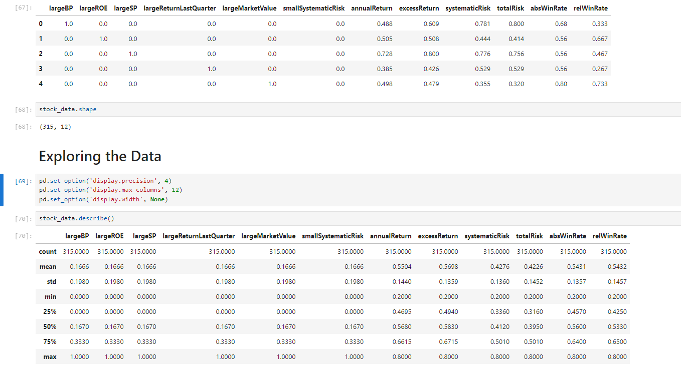

Slide 10
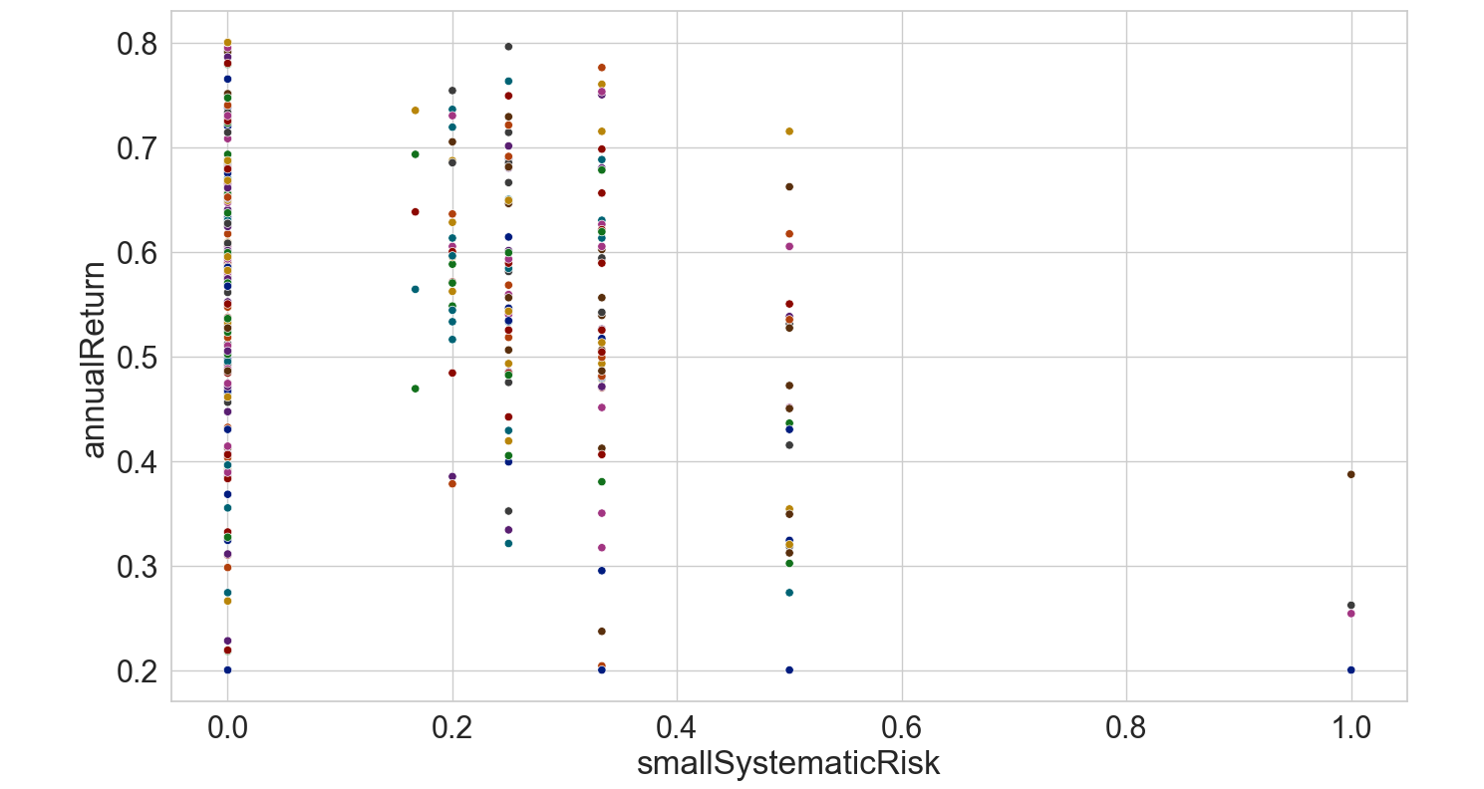

Slide 11
Data Source
Data available in the UCI data repository
Data set: https://archive.ics.uci.edu/dataset/390/stock+portfolio+performance
Research Paper:
https://www.researchgate.net/publication/284244181_Using_mixture_design_and_neural_networks_to_build_stock_selection_decision_support_systems

Slide 12
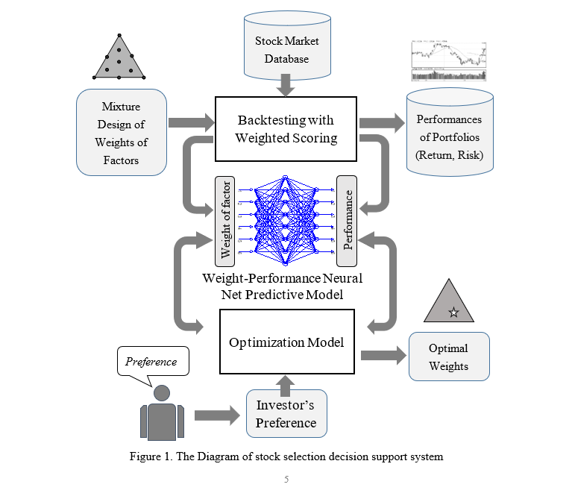

Slide 13
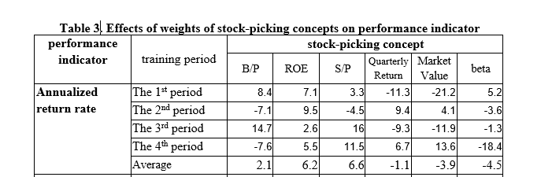
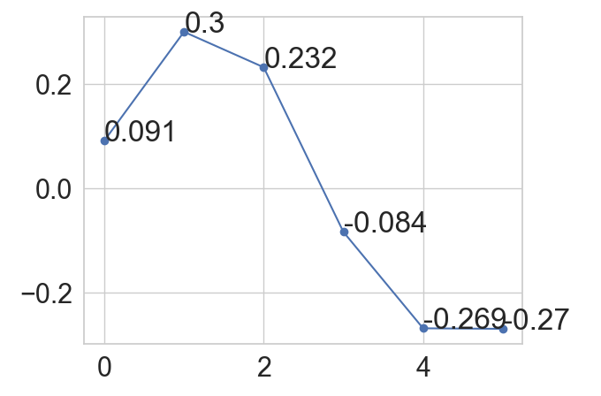
Source Solution
Developed similar trends in coefficient values
Successfully replicated coefficient trends for several dependent variables

Slide 14
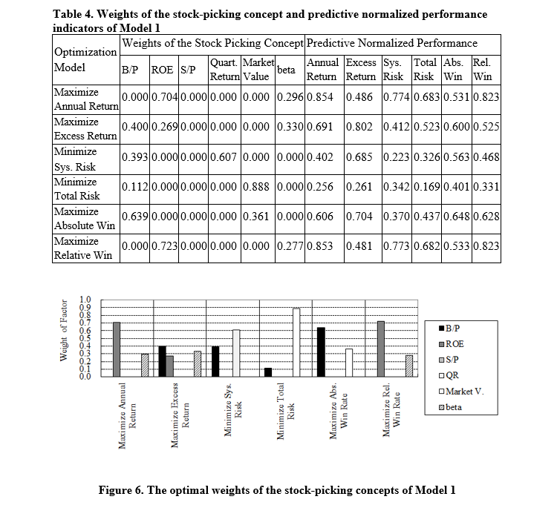

Slide 15
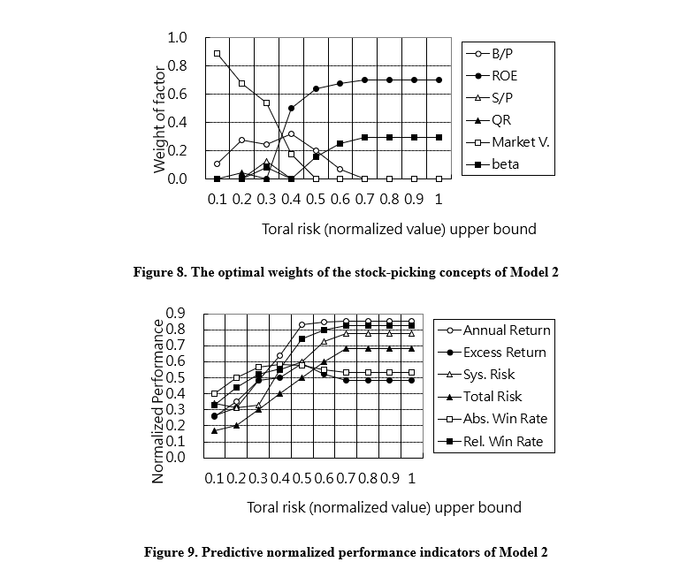

Slide 16
Performance Metrics
Was the model able to successfully develop working coefficients
Did the independent coefficient value correlate with the found values
Was the model able to make successful predictions with training
How successful were these predictions
Could the model work with limited information
Could improvements be made to the model

Slide 17
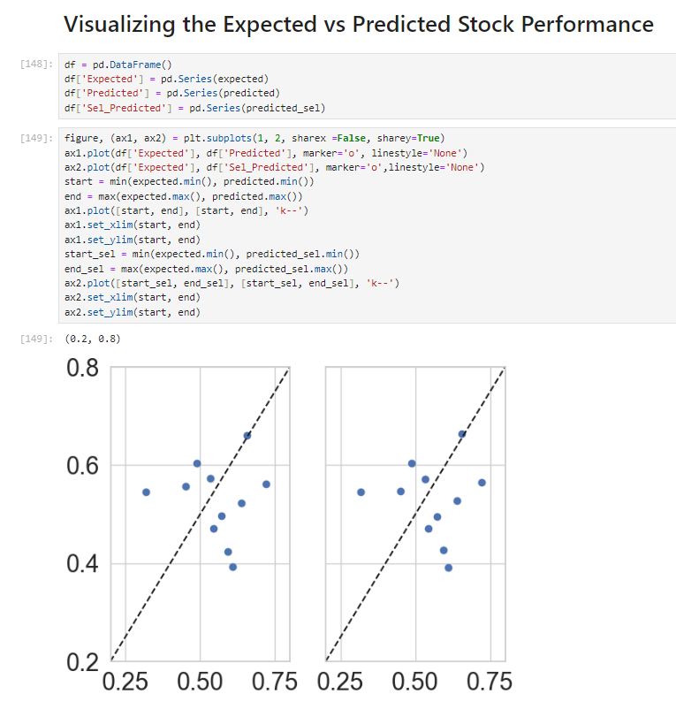
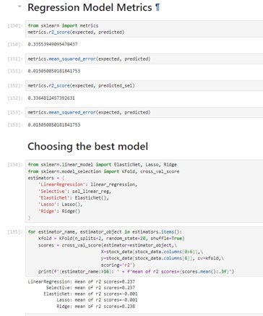

Slide 18

Conclusion
Successful development of data visualizations and correlation
Successful development of limited data model predictions
Dubious ability to predict beyond dataset
Low R2 scores
Low scores across other models
Potentially limited Dataset

